Slide 1
SL Physics multiple choice questions
Nov 2011

Slide 2
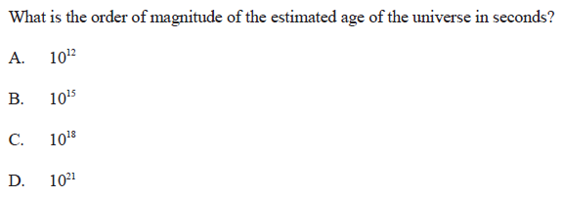
Age of the Universe

Slide 3
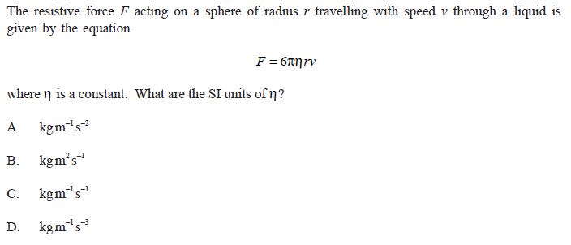
SI Units

Slide 4
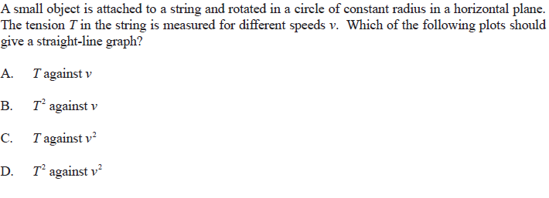
Centripetal Force

Slide 5
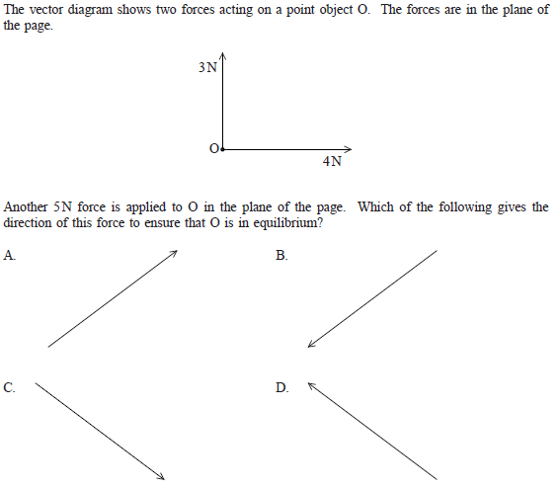
Vector Sum

Slide 6
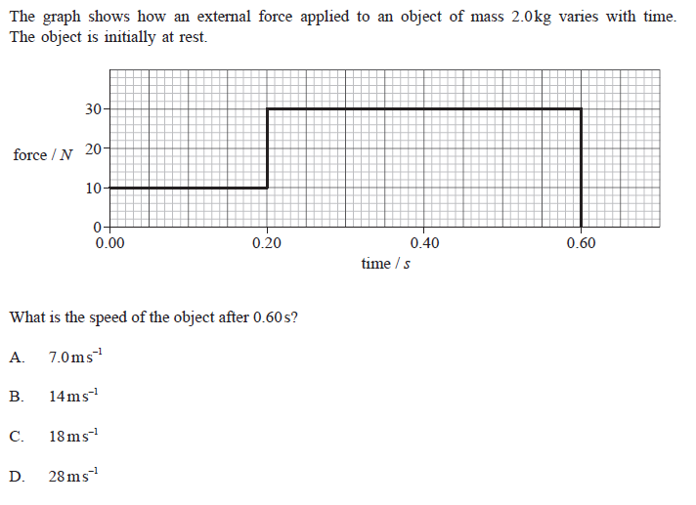
Acceleration

Slide 7
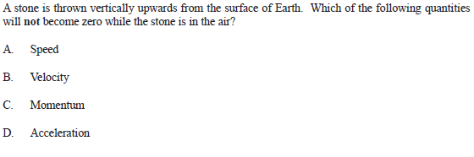
Motion under gravity

Slide 8
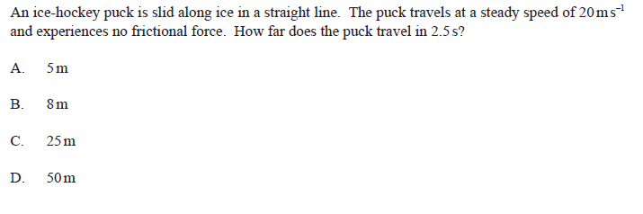
Easy one?

Slide 9
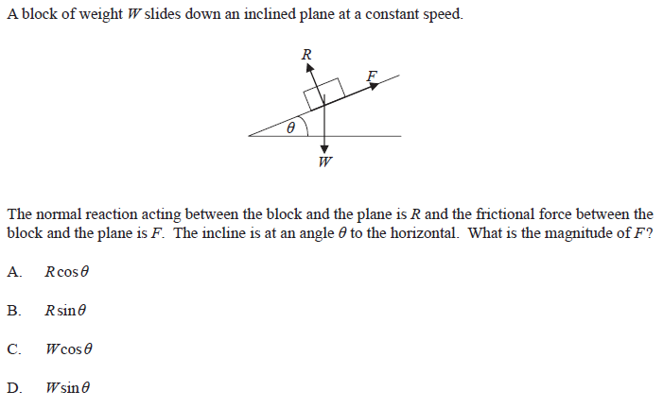
No resultant force

Slide 10
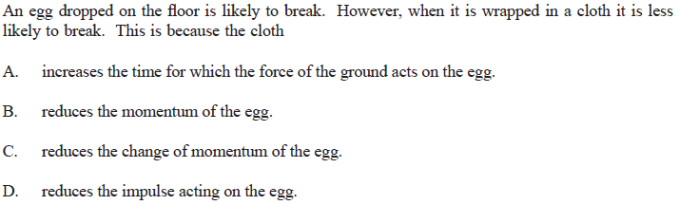
Egg drop

Slide 11
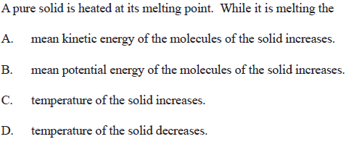
Heating

Slide 12
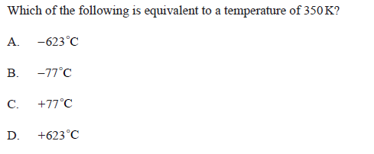
Kelvin Temperature

Slide 13
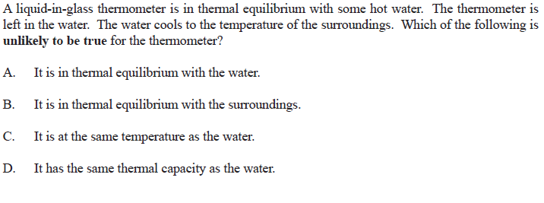
Thermometer

Slide 14
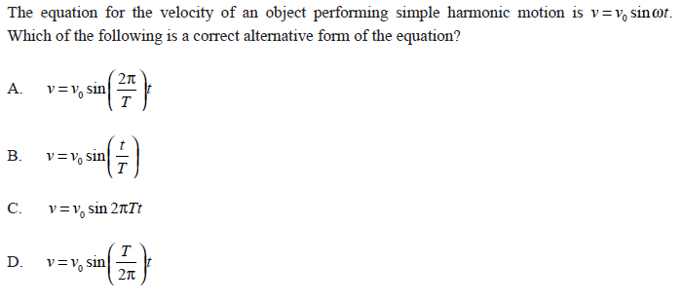
SHM 1

Slide 15
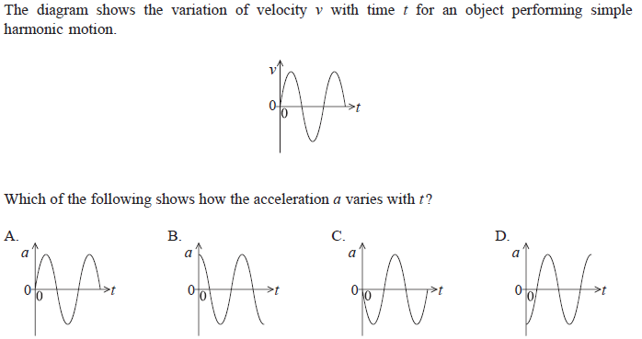
SHM 2

Slide 16
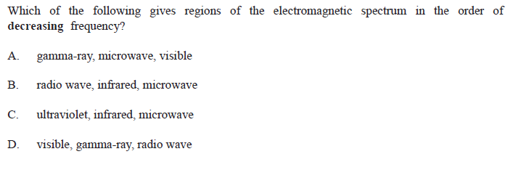
Electromagnetic spectrum

Slide 17
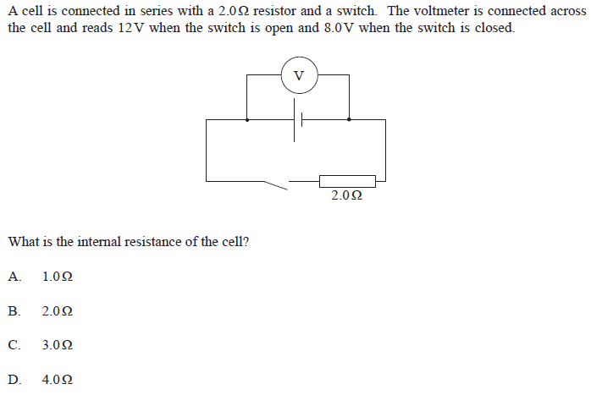
Internal resistance

Slide 18
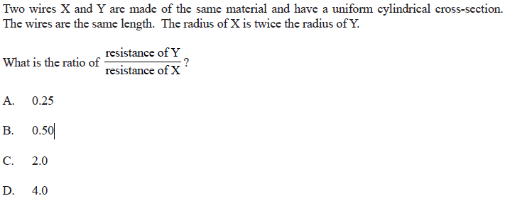
Resistance of wire

Slide 19
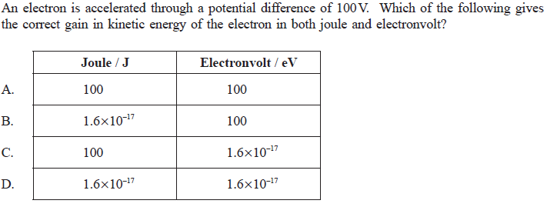
Electron Volt

Slide 20
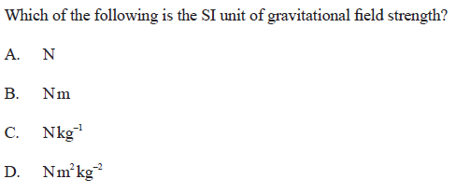
Gravitational Field

Slide 21
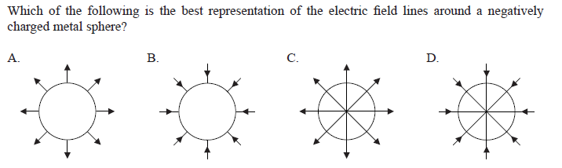
Electric Field

Slide 22
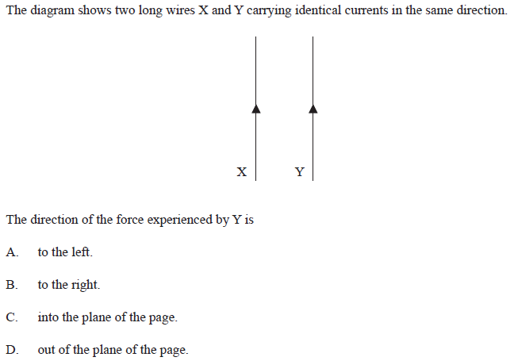
The Ampere

Slide 23
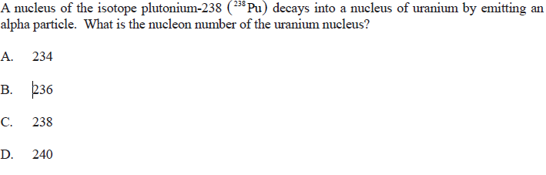
Alpha decay

Slide 24
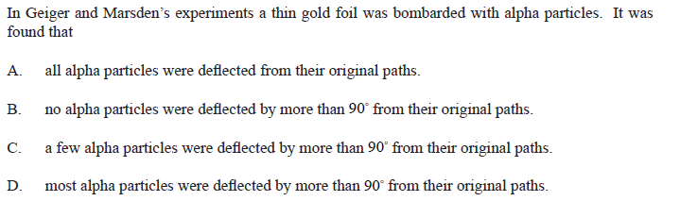
Alpha scattering
http://www.miniphysics.com/2010/11/emf-induced-in-straight-conductor.html

Slide 25
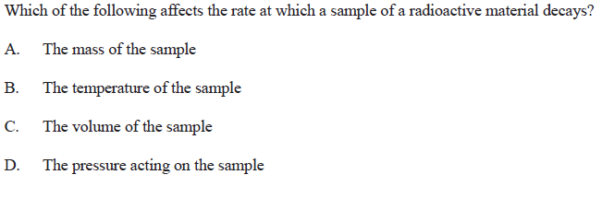
Decay

Slide 26
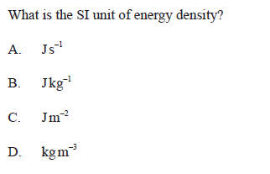
Si Units 2
or Jmol⁻¹ for Chemists

Slide 27
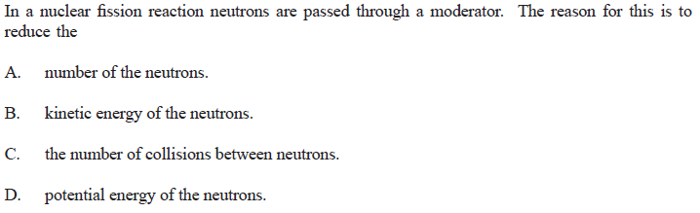
Fission

Slide 28
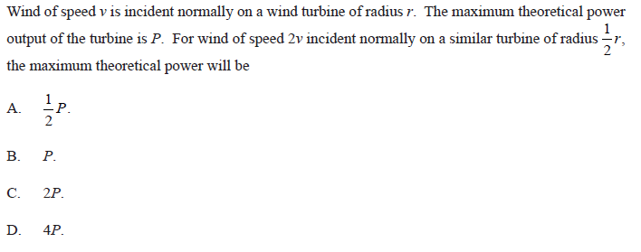
Wind power

Slide 29
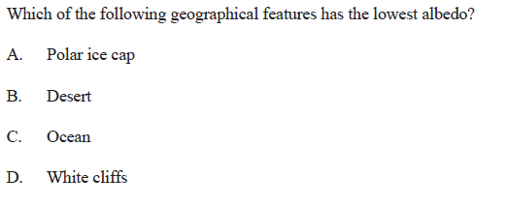
Albedo

Slide 30
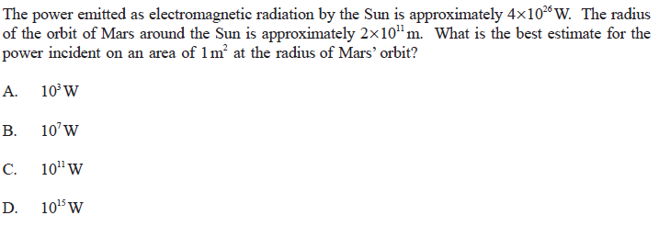
Intensity

Slide 31
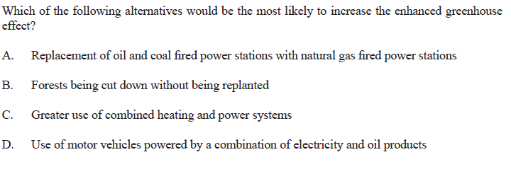
Enhanced greenhouse effect

